Slide 1
Light Building 2020
The world’s leading trade fair for lighting and building services technology

Slide 2
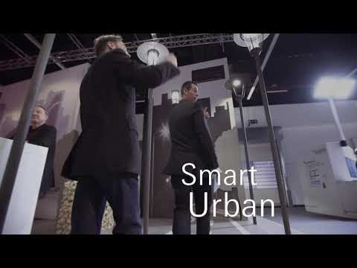

Slide 3










Light Building 2020
X as a Service
Connecting
Digitalisation
Connected security
Predictive maintenance
Advanced e-charging infrastructure
Home & Building automation

Slide 4
Fontys Light Building Event Agenda: 2020-Mar-09
2020-Mar-09
6:00: Bus leaves from Fontys R1
10:00: Bus arrives at Frankfurt am Main
16:30: Bus leaves from Frankfurt am Main to a Restaurant
19:00: Bus drives back to Eindhoven
Submission deadline: 14-Feb-2020

